Slide 1
Iowa Liquor Sales
Business Description
DAE Student, Yuliya Yeusyevich
24.05.2023

Slide 2
Iowa Liquor Sales
Welcome Iowa-based spirits retailer, offering an extensive range of alcoholic beverages to customers throughout the state, serving two regions: Northwest and Iowalakes.

Slide 3
DWH STRUCTURE
Hybrid approach:
Staging area
Normalized layer
Dimensional layer

Slide 4
STAR SCHEMA

Slide 5
SNOWFLAKE SCHEMA

Slide 6
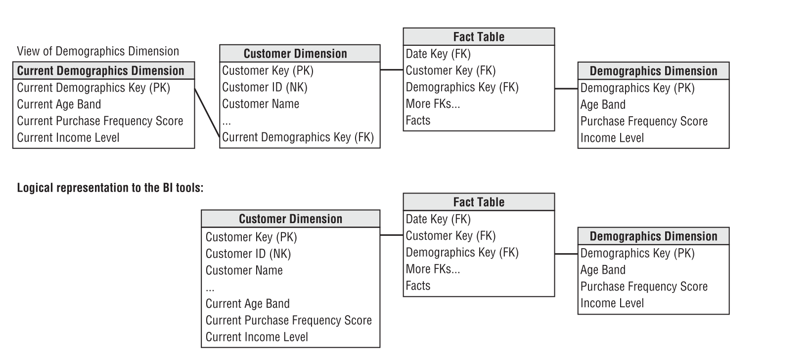
SCD type 5
Mini dimension and type 1 Outrigger

Slide 7
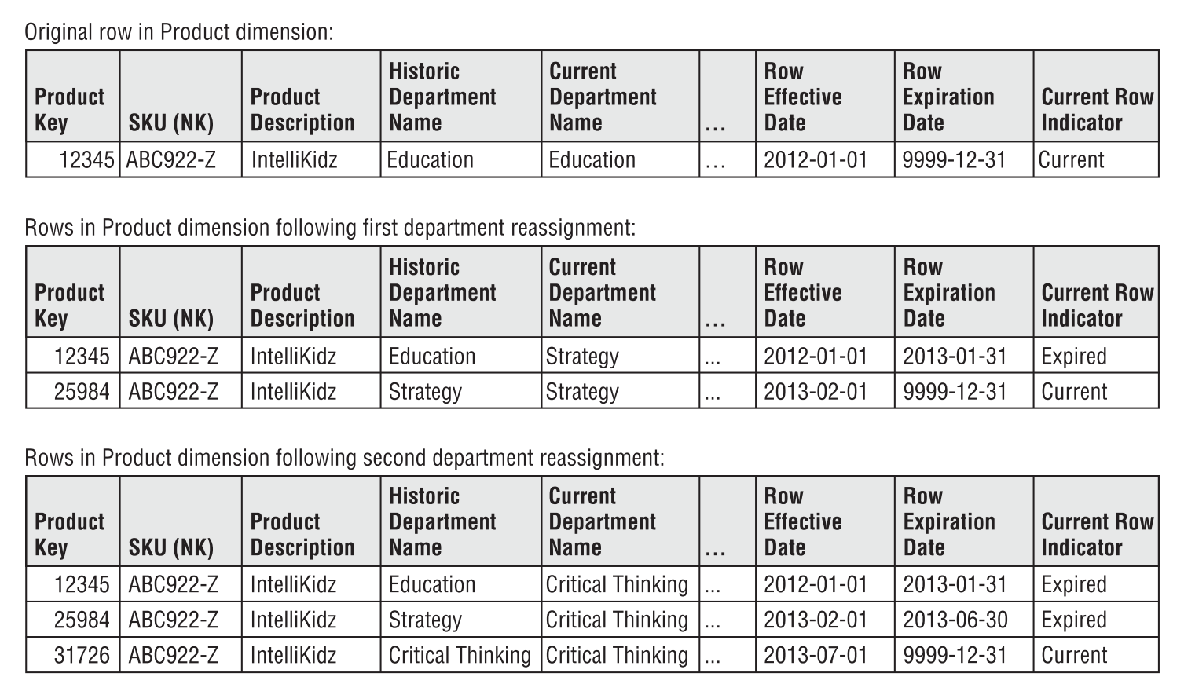
SCD type 6

Slide 8
DATA FLOW

Slide 9
Iowa Liquor Sales
Code.

Slide 10
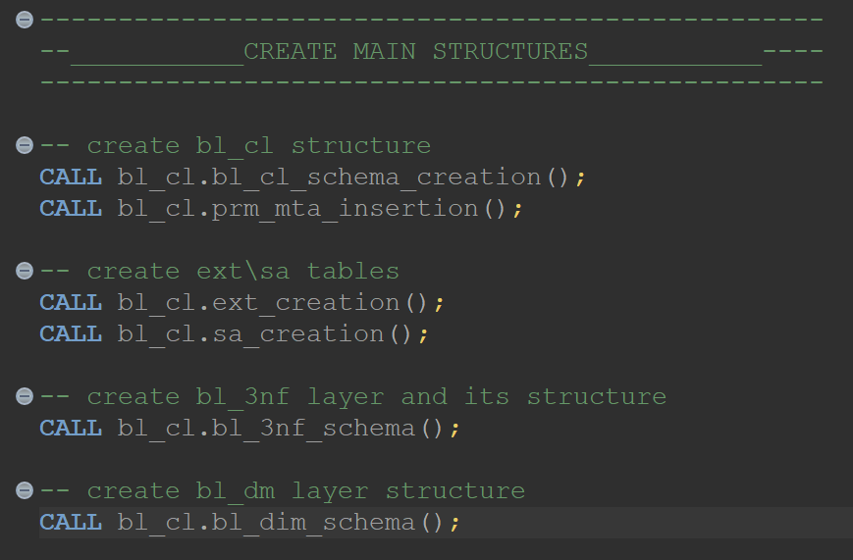
Create main structures
schemas for three layers;
prm_mta-table;
external tables;
src tables;

Slide 11
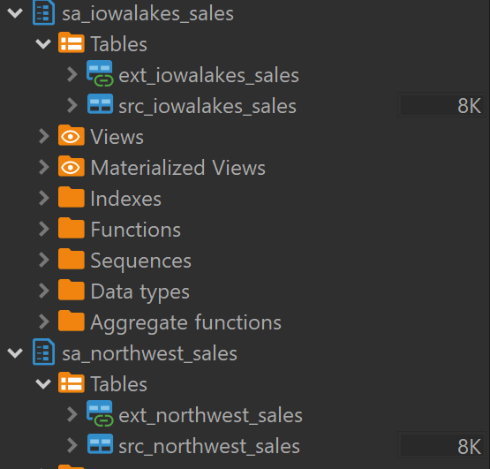
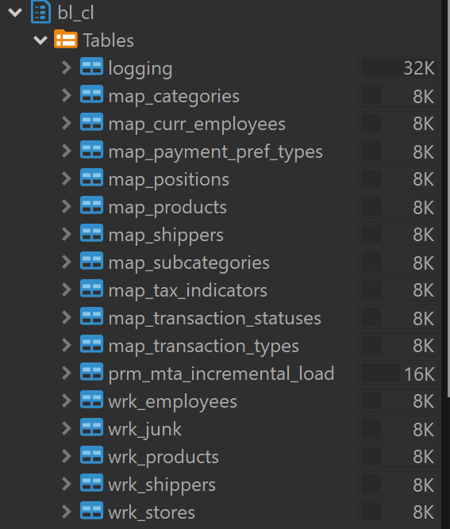
Sa (2) and bl_cl (17) objects

Slide 12
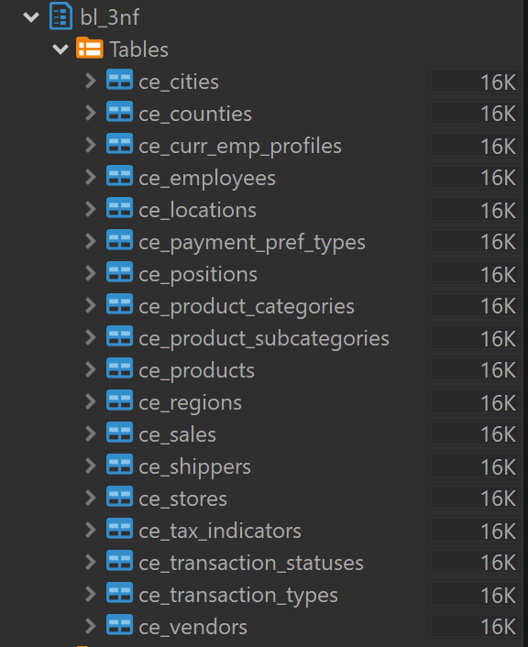
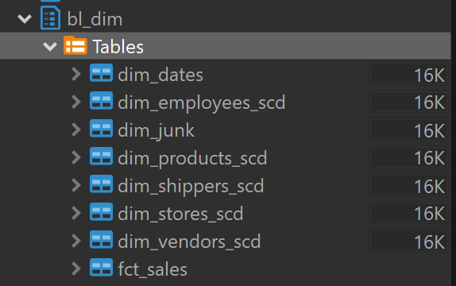
Bl3nf (18) and bldim objects (8)

Slide 13
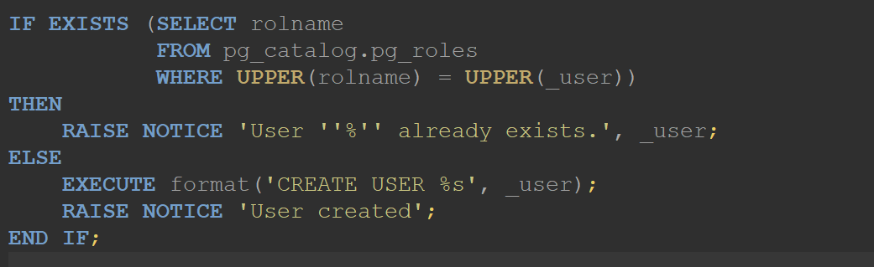
User creation
PROCEDURE bl_cl.user_creation(_user TEXT)

Slide 14

SA loading
1792797 rows;

Slide 15
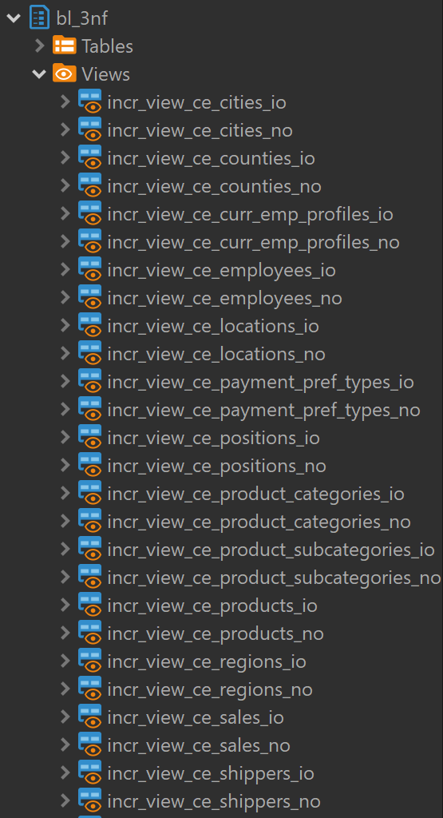
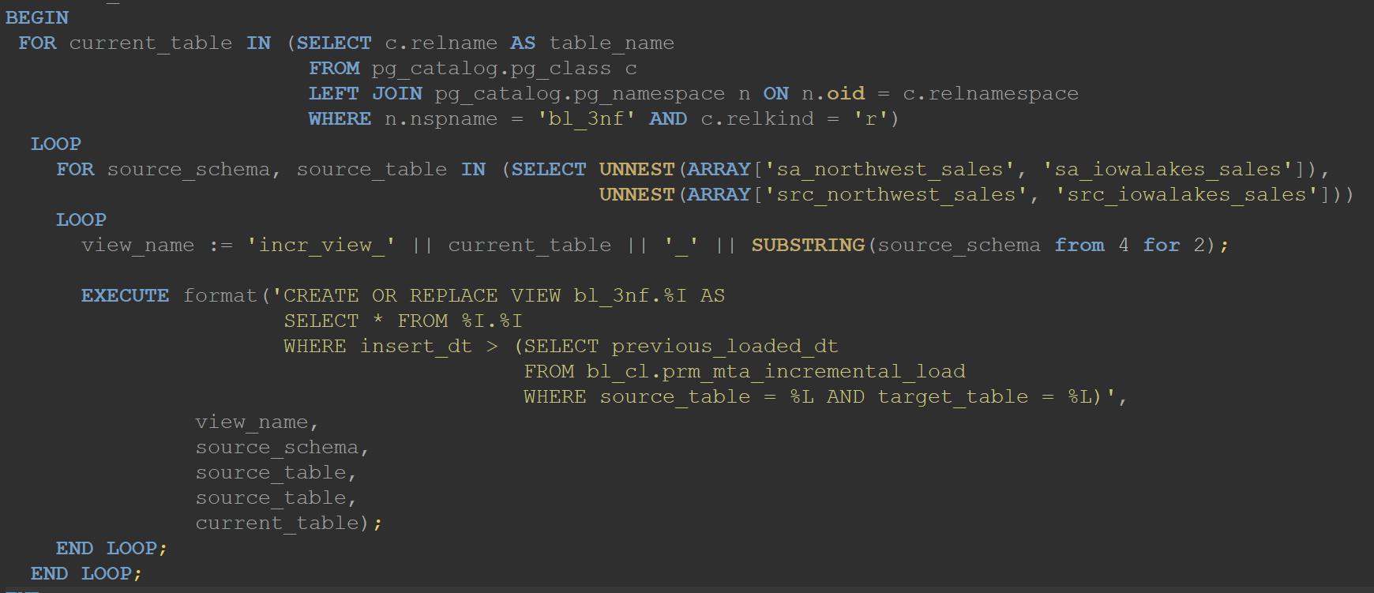
Views

Slide 16
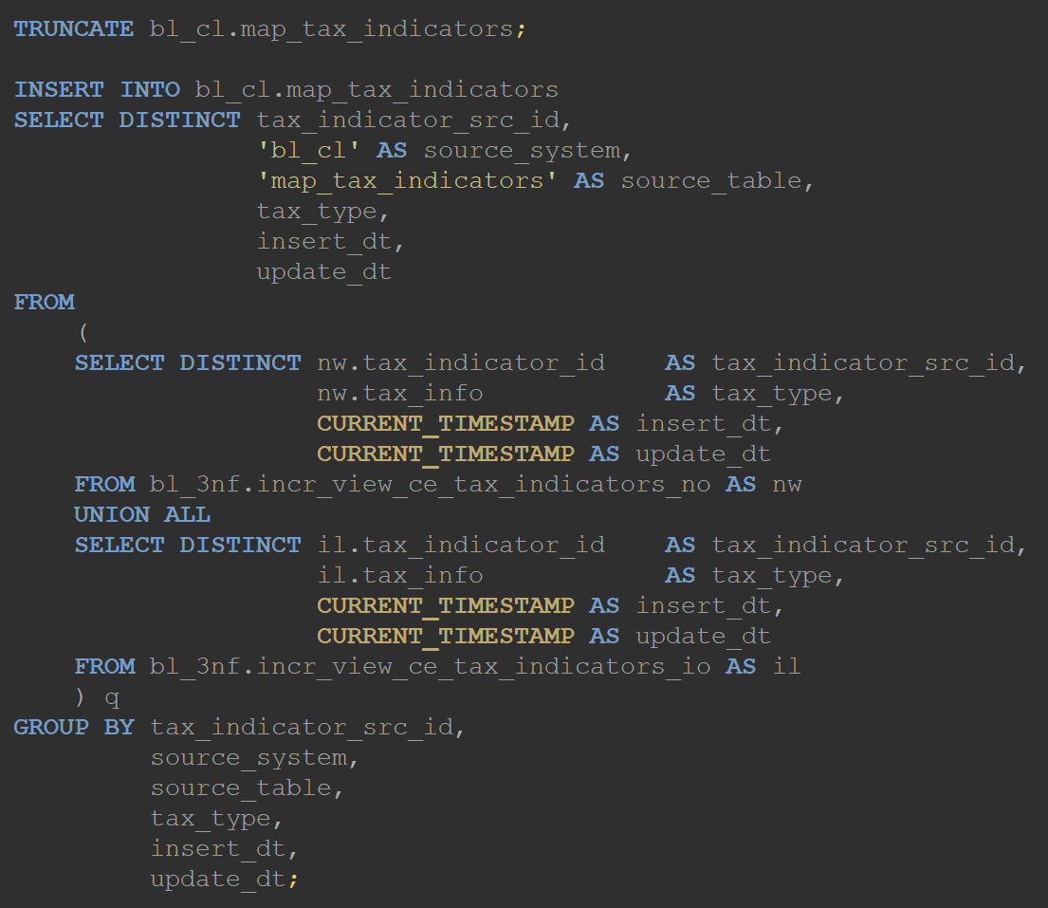
Mapping tables
in bl_cl layer;
deduplication purpose;
take data from views;
truncated before load;
Only updated data selected.

Slide 17
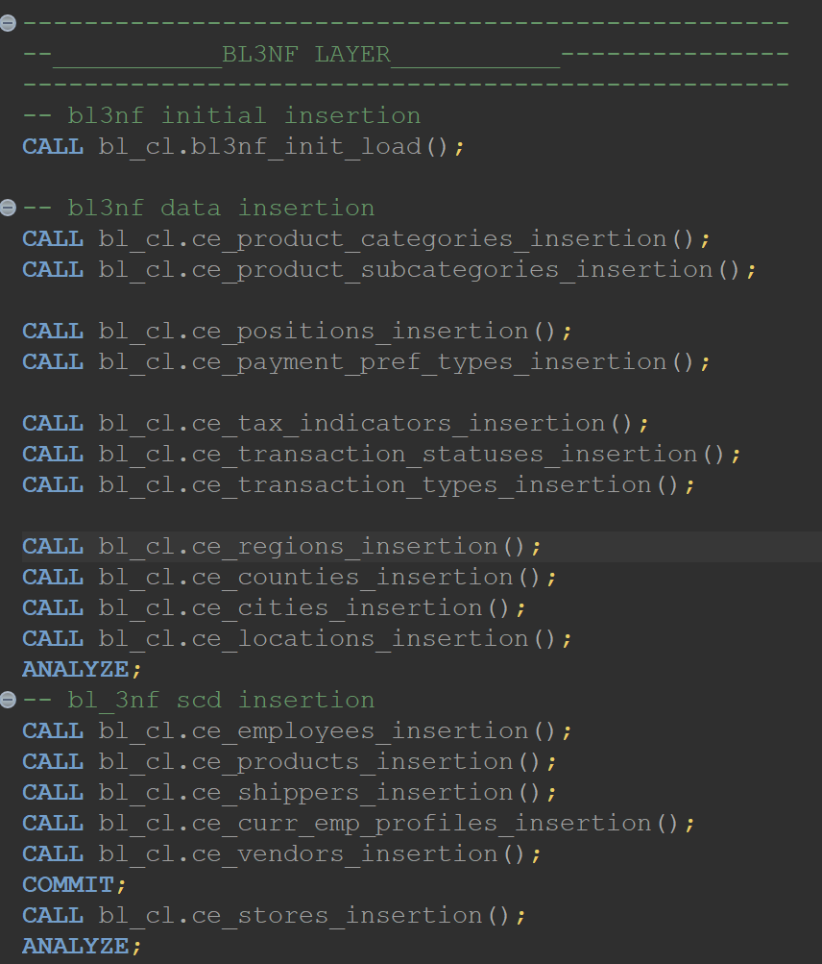
Bl3nf insertion

Slide 18

Fact table loading

Slide 19
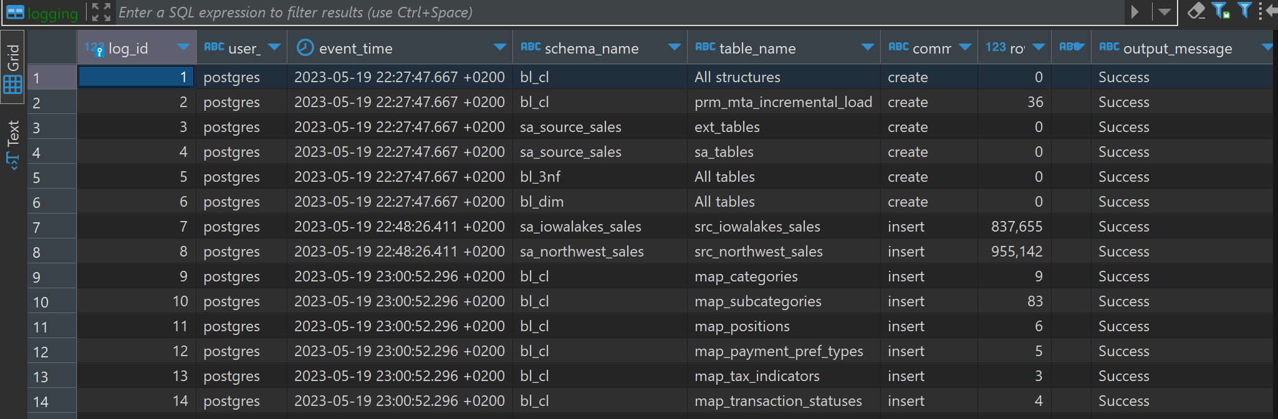
Logging table

Slide 20
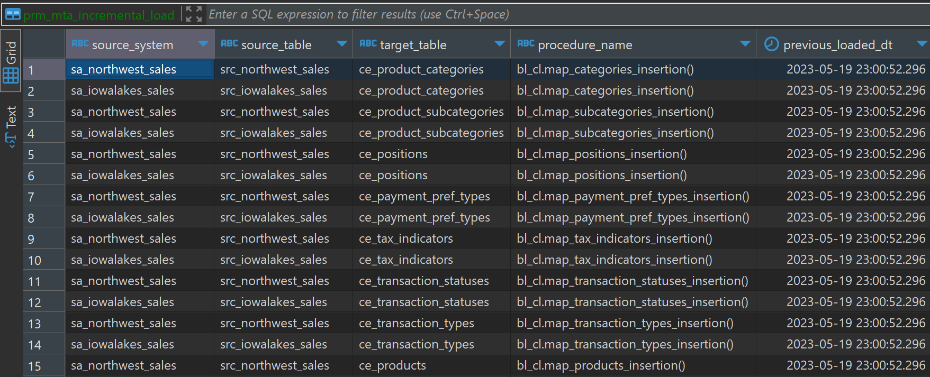
MTA table

Slide 21
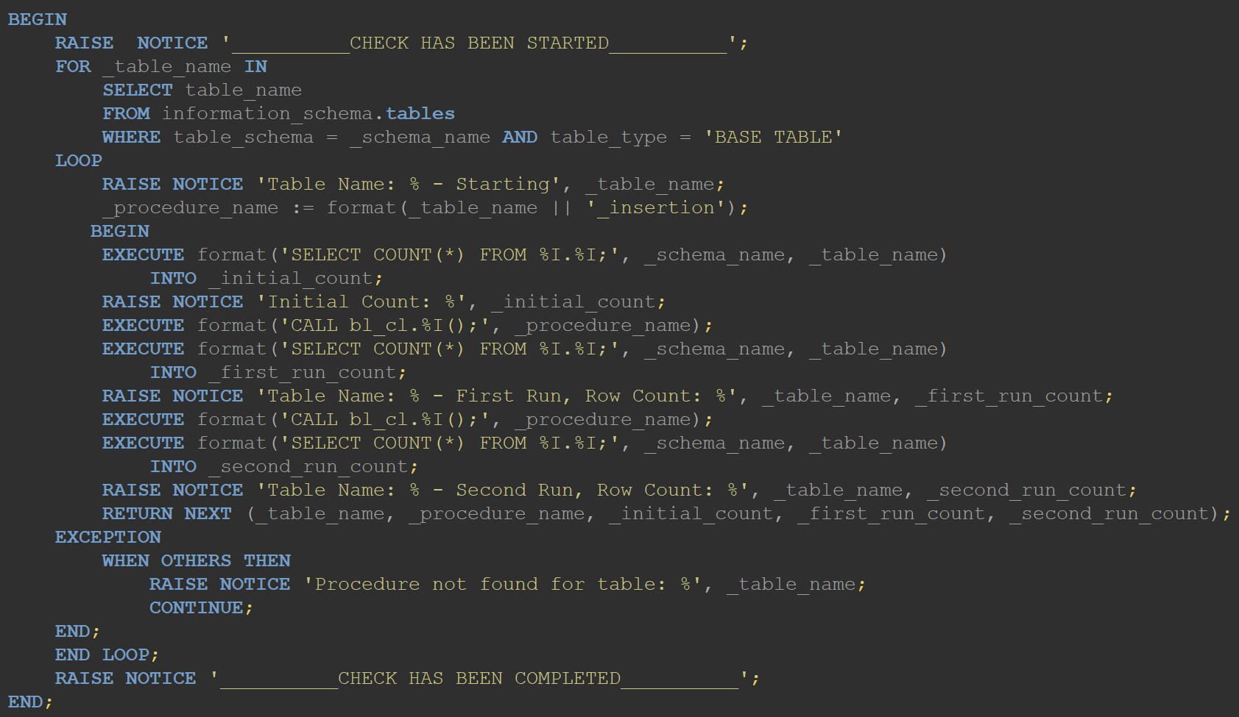
Double check function

Slide 22
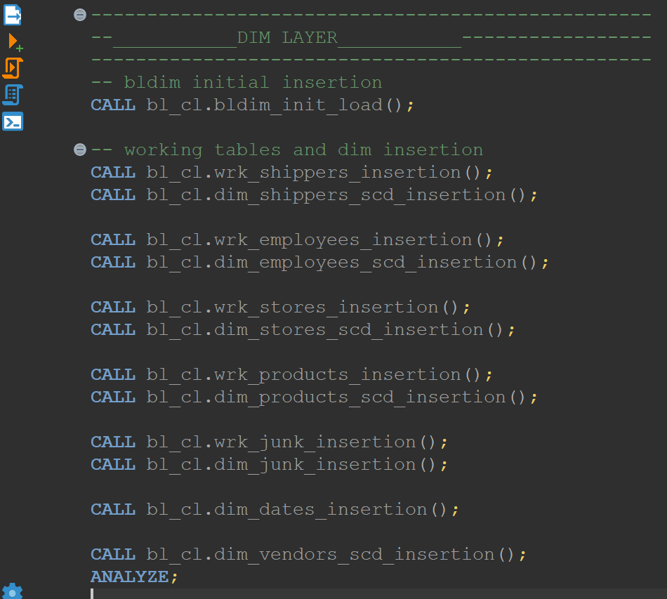
Bldim insertion

Slide 23
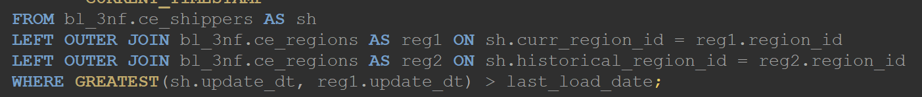
Working tables
PROCEDURE bl_cl.wrk_shippers_insertion()
MTA table alternative: only updated data selection;

Slide 24
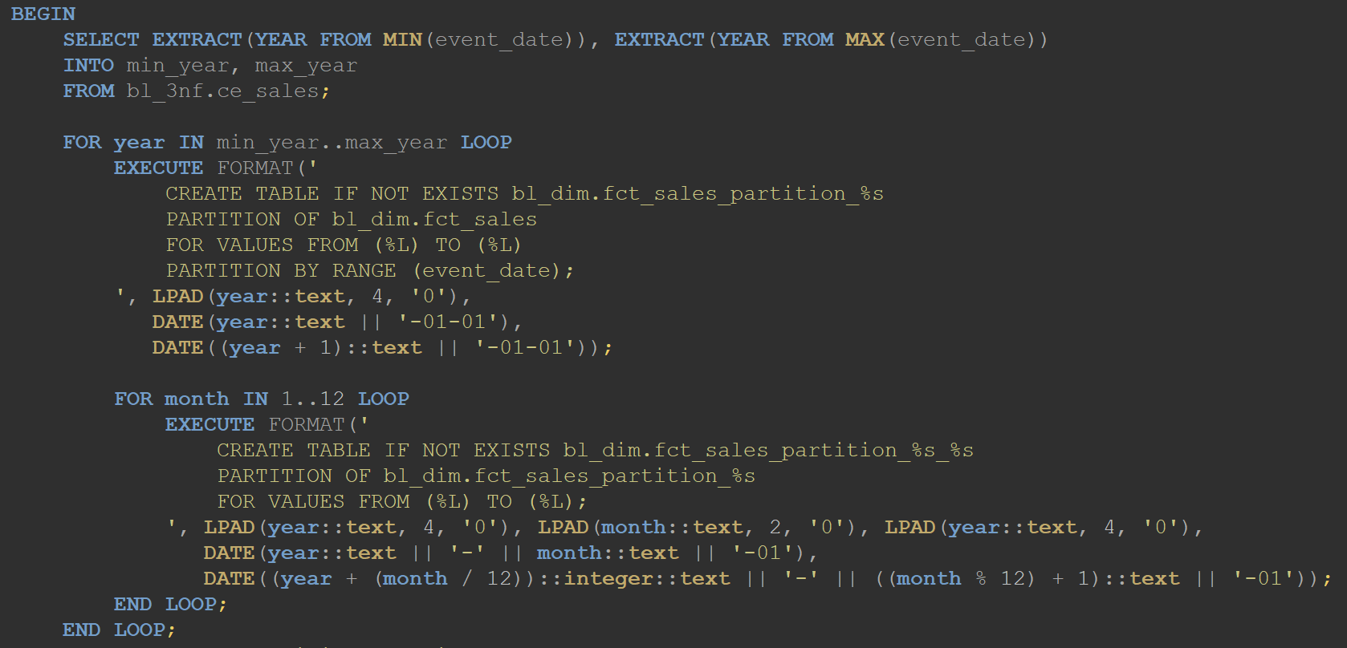
Partitions creation

Slide 25
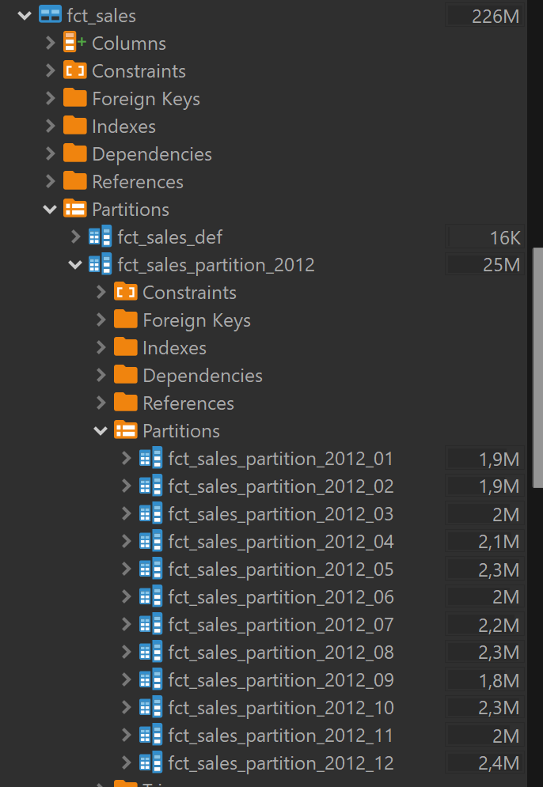
Partitions (result)
Primary partitioning by range of dates – years;
Subpartitioning by range of dates – months;

Slide 26
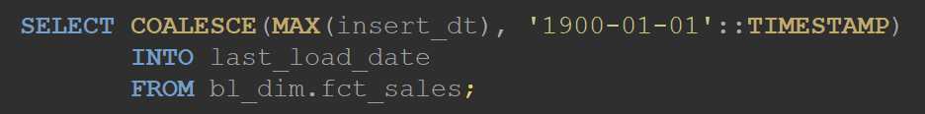

Fact insertion (last load date strategy)
Filtering records from bl3nf fact table based on MAX insert date in bldim fact table;

Slide 27
Fact insertion (result)

Slide 28
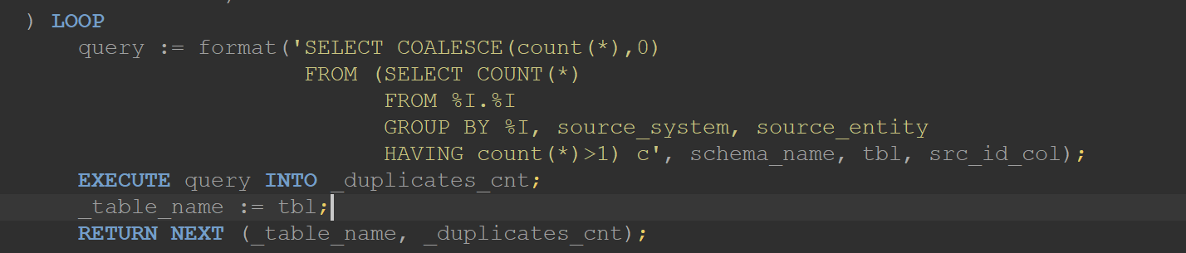
Test type one (duplicates)
FUNCTION bl_cl.duplicated(schema_name TEXT)
No duplicates in SCD enteties because no changed were made;

Slide 29
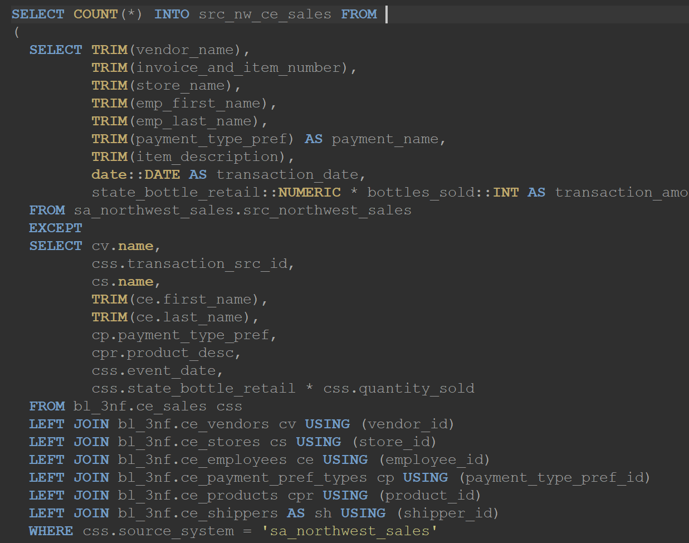
Test type two (main business keys)
FUNCTION
bl_cl.missing_rows()

Slide 30
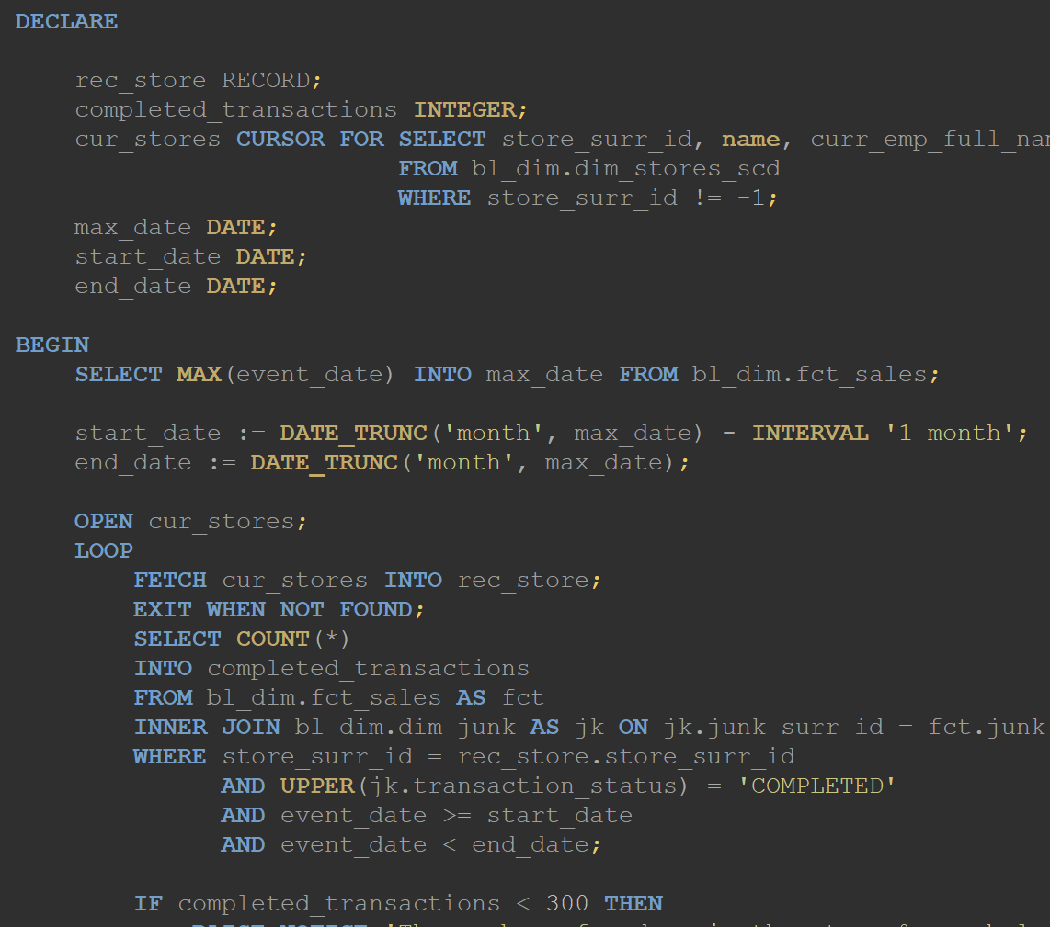
Analytics (cursor func)
FUNCTION
bl_cl.low_sales_notification()

Slide 31

Incremental load
94359 rows

Slide 32
SCD type 5
Mini dimension and type 1 Outrigger

Slide 33
SCD type 5
The type 4 mini-dimension terminology refers to when the demographics key is part of the fact table composite key. If the demographics key is a foreign key in the customer dimension, it is referred to as an outrigger.

Slide 34
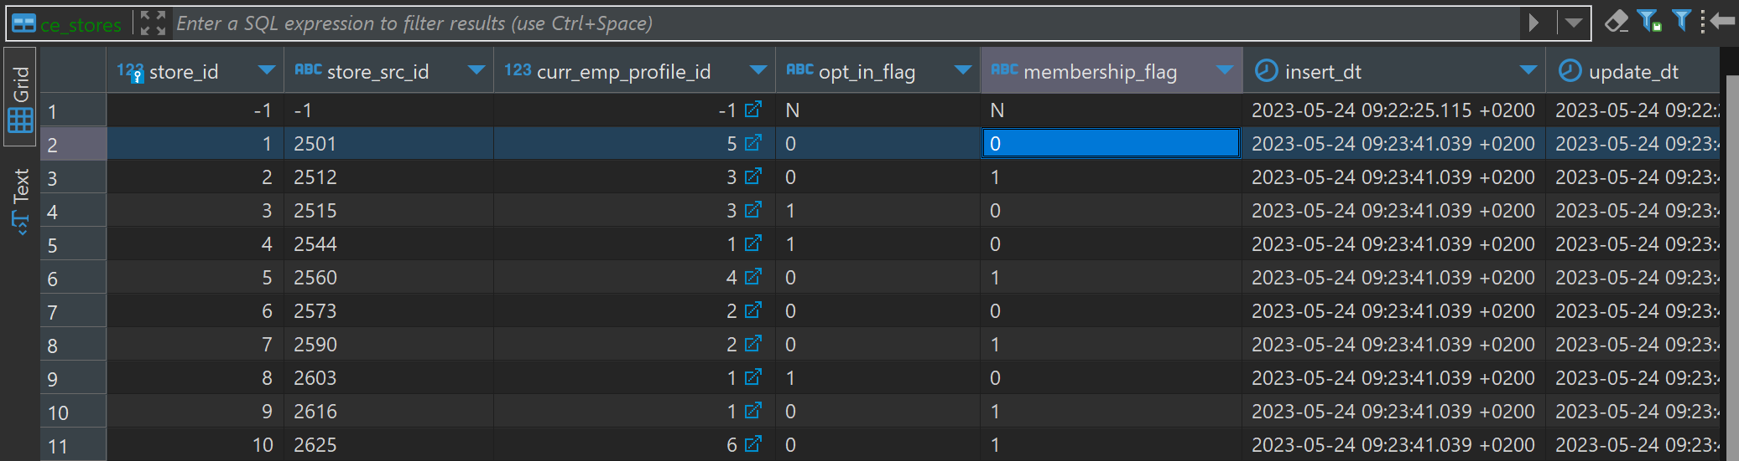
Stores before…
*put the screenshot here

Slide 35
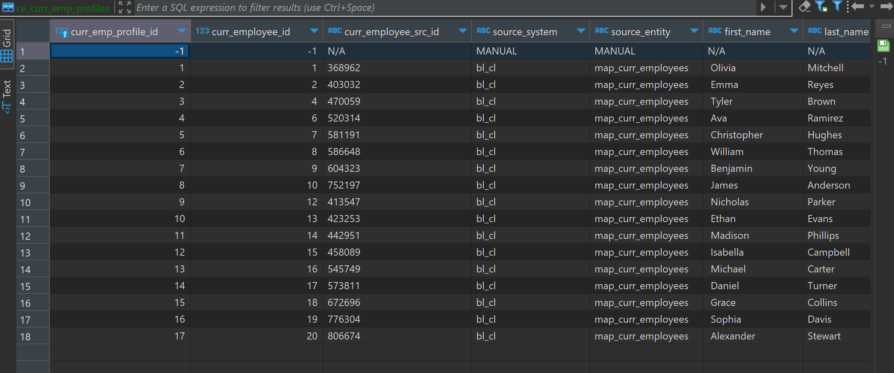
Curr_emp_profile before…
*put the screenshot here

Slide 36
Bl3nf loading…

Slide 37
Stores and employee profiles after…

Slide 38

Bl3nf fact table

Slide 39
Bldim loading…

Slide 40
Bldim fact loading

Slide 41
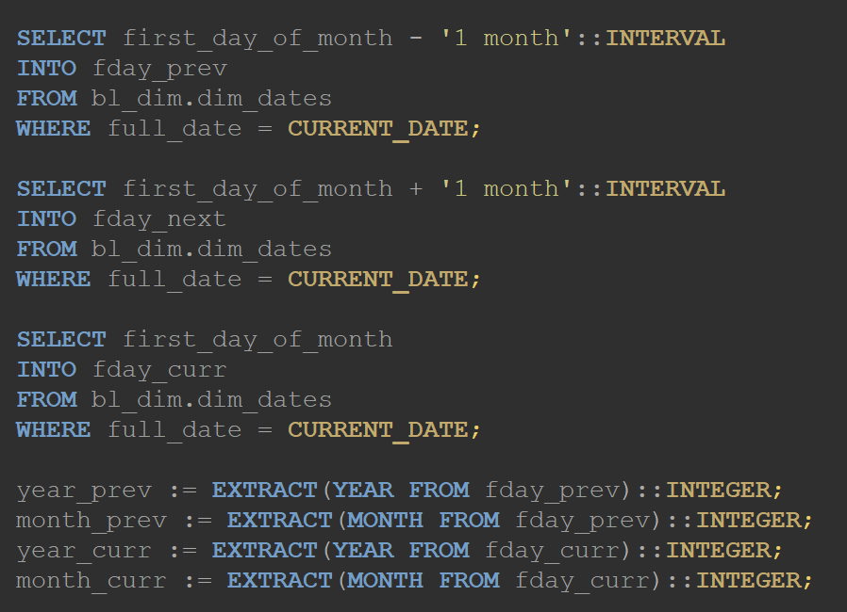
Partitioning strategy closer…
define time boundaries…

Slide 42
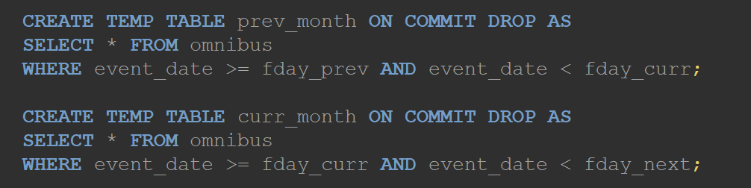
Create temporary tables…

Slide 43
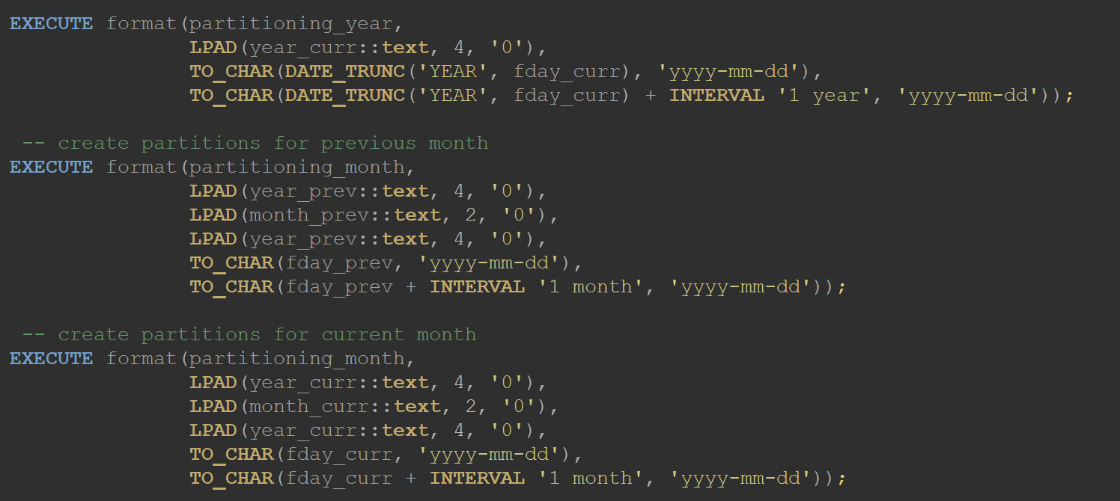
Create partitions…

Slide 44
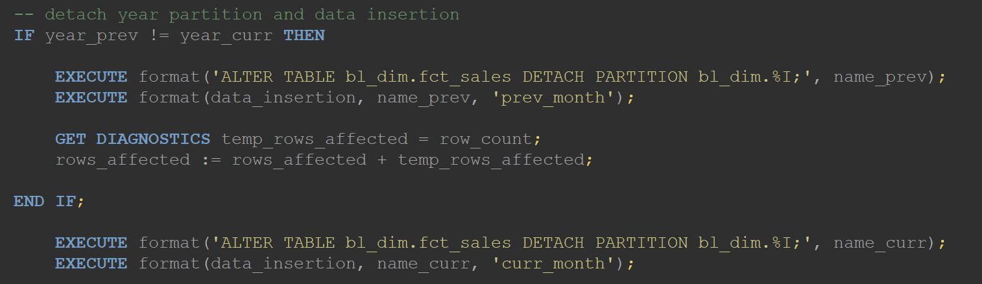
…and detach them -> insert data

Slide 45
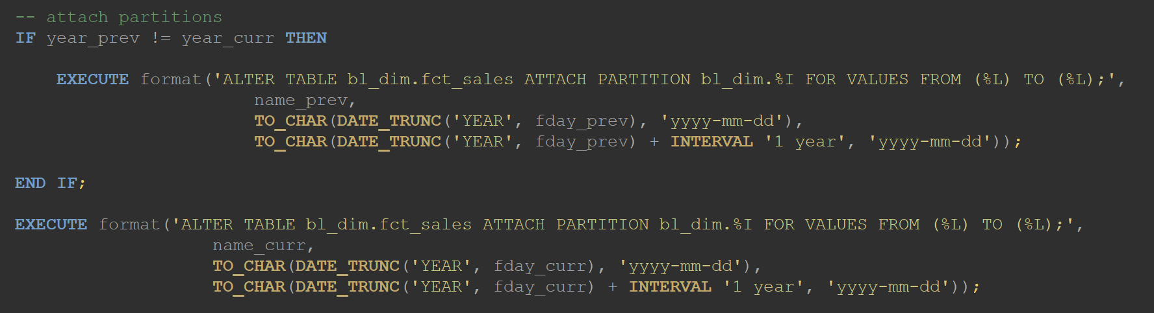
attach partitions

Slide 46
SCD type 6

Slide 47
SCD 6 DEMO

Slide 48
THE END

